Slide 1
Keras Code Structure
-Visualize a Neural Network
-Burrito Metaphor
-Building a model
-TensorFlow vs. Keras
-Conclusion
Jack Wu

Slide 2
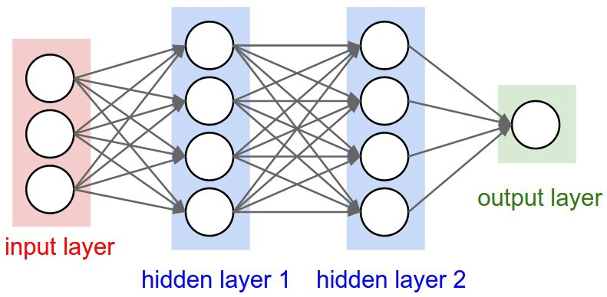
Visualize a Neural Network
Review: Multilayer Perception model is layers of nodes stack on top of each other, it has at least three layers: input layer, hidden layer, and output layer.
A lot of people think of building a Keras model is like making a cake or wrap a burrito, by adding layers of stuff and wrap them into a big piece.
We will talk about the burrito metaphor.
Image Credit: https://miro.medium.com/max/978/0*0mia7BQKjUAuXeqZ.jpeg

Slide 3
Neural Network: A Burrito
Imagine you walk into a Mexican restaurant.
You ordered a burrito, and you want a steak burrito with cheese on it.
Your burrito starts with a big tortilla. The chef first put a layer of rice, and a layer of steak, then a layer of beans, then a layer of cheese, and finally a layer of salsa.
The chef wraps everything into a single burrito, and you are happy.

Slide 4
Burrito: A Neural Network
Suppose you want to construct a neural network.
You think you need a ML model, and you want to build Multilayer Perception model, for example.
You give a name to your model. Then you tell Keras what layers to add. Keras first adds a layer of input nodes, then several layers of hidden nodes in your will, and finally a layer of output nodes.
Keras wraps everything into a single ML model and hand it to you, and you are done and you can now go and grab a real burrito.

Slide 5
Building a Multilayer Perception Model
Step 1: Construct a sequential model.
Think of this as the process of picking a tortilla.
Step 2: Add layers into the model using Keras built in models.
Think of this as adding steak and rice into the tortilla.
Step 3: Add output layer to the model.
Think of this as wrapping the tortilla into a burrito
And that is it!

Slide 6
It is easy! Easy to understand, and easy to code as well. We will cover the coding in the future. Now just understand the big idea.

Slide 7
TensorFlow vs Keras
Keras
-Easy to learn.
-Relatively less flexible.
-High productivity.
-Beginner friendly.
-Don’t need to design tensor operation
TensorFlow
-Significantly harder to learn.
-Very flexible.
-Relatively low productivity.
-Best for professionals.
-Need to design tensor operation

Slide 8
Conclusion
This course is for beginners who don’t know much about machine learning, so if we go straight forward and learn TensorFlow, we will encounter complicated tensor operations, hard mathematics, and most humans will quit.
But the purpose is to get started with neural network, so we first learn the basics, then after we have a big picture of machine learning and comfortable with coding we can go further with TensorFlow.

Slide 9
END

